Slide 1
Blockchain-IoT case Studies
Dr. Bhawana Rudra
NITK

Slide 2
IoT enables devices across the Internet to send data to private blockchain networks to create tamper-resistant records of shared transactions

Slide 3
Supply Chain and Logistics
Automotive Industry
Smart Homes
Sharing Economy
Pharmacy Industry
Agriculture
Water Management

Slide 4
Supplychain

Slide 5
Automotive Industry

Slide 6
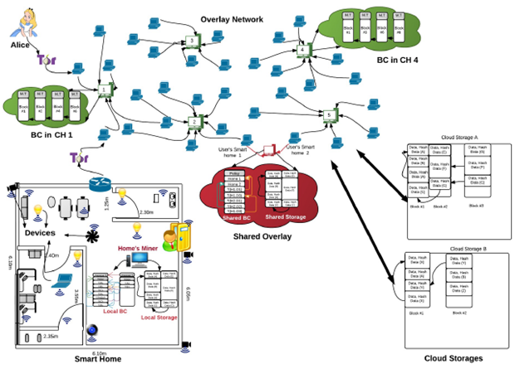
Smart Home

Slide 7
Sharing Economy

Slide 8
Pharma Industry

Slide 9
Agriculture

Slide 10
Thank You

